Slide 1

ALY 6015 - Intermediate Analytics Final Project – Telco Customer Churn Analysis
By –
Bhagyashri K ,Shyamala V , Xiaoge Z
& Yuchen Z

Slide 2
Contents
Introduction
Scope of Project
Exploratory Data Analysis (EDA)
Application of Statistical Tests
Model
Building and Evaluation
Results & Conclusion

Slide 3
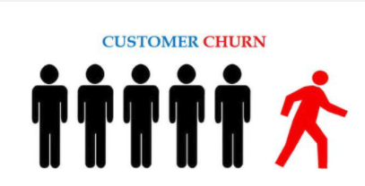
What is Customer Churn & Why is it Important ?
Customer Churn is the percentage of customers that have stopped using any company’s product or service during a certain timeframe
Customer Churn is important because losing customer is losing revenue
Analyzing Customer churn can increase profits , improve Customer experience .optimize products & services & Customer Retention.
A company should aim for a churn rate that is as close to 0% as possible.
Predicting churn is a fact for any business, and even slight fluctuations in churn can have a significant impact on company’s bottom line. We need to know: “Is this customer going to leave us within X months?” Yes or No?

Slide 4





Telco Customer Churn - Dataset Introduction
The Telco Customer Churn dataset contains information about a fictional Telco company that provides home phone and Internet services to 7043 Customers in California in Q3.
It Indicates which customers have left , stayed , or signed up for their services.
Customer churn indicator – If a customer has left the company or not
Demographic info about customers – gender,Senior Citizen, and if they have partners and dependents
Services that each customer has signed up for – phone, multiple lines, internet, online security, online backup, device protection, tech support, and streaming TV and movies , etc,
Customer account information – how long they’ve been a customer, contract, payment method, paperless billing, monthly charges, and total charges

Slide 5

Scope of the project
What are the factors/services that would help predict the Customer Churn ?
Do any of the Services that Customer has signed up for contribute to the Customer Churn ? (e.g -Online Security , Tech Support , Streaming movies etc.)
Does demographic information of Customers (example - Gender , Senior Citizen , Dependents etc.) contribute to Customer churn rate ?
Are Customers with less tenure more likely to be Churned ?
Is the average monthly charge same across all the types of internet service?
Are the churned customers independent of the contract type?

Slide 6
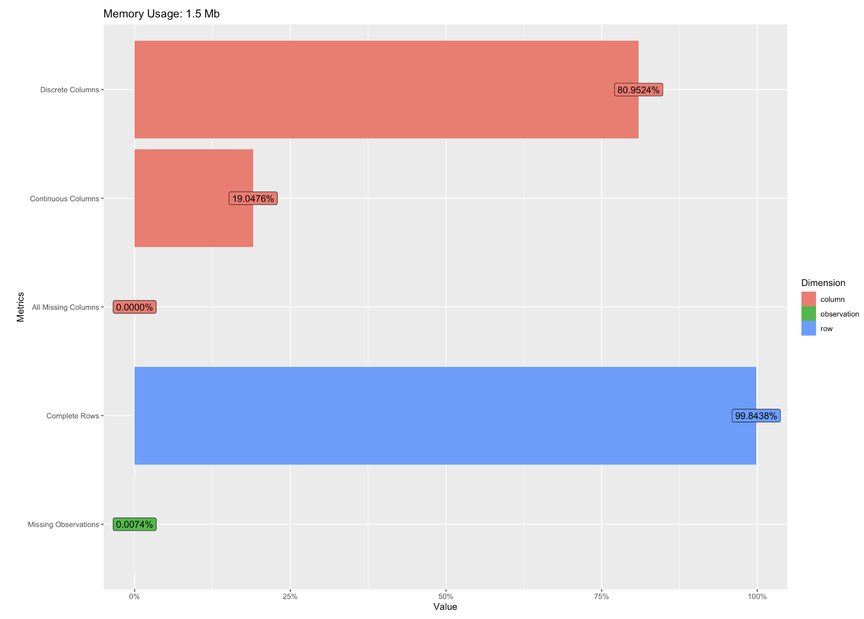
Exploratory Data Analysis
17 Categorical variables
3 Continuous variables

Slide 7
Exploratory Data Analysis
Data Cleaning
Visualizing Patterns
Data Transformation
Studying Correlation
Removed unwanted column - “Customer ID”
Imputed missing values of “Total Charges” attribute with its mean value.
Identified the outliers and replaced with its mean value
Treatment of some character features as Factors.
Recoded the categorical variables to numeric values.
A correlation matrix was generated to study the relationship between the variables.
This step can be useful to avoid feeding the model with highly correlated features,hence preventing multicollinearity issue.
Visualized all the categorical and numeric features to identify relationships between them.

Slide 8
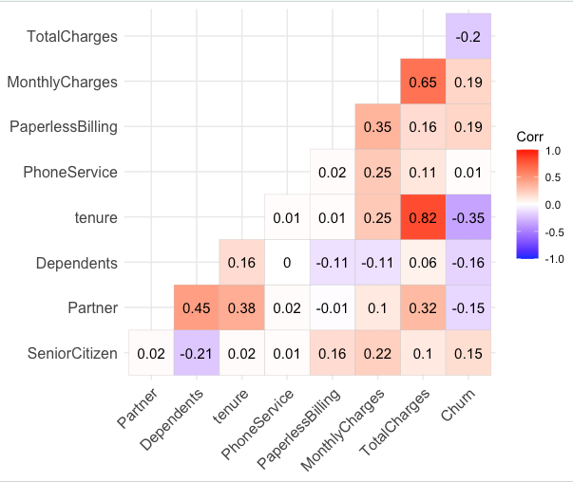





Correlation
1
Churn is correlated with Monthly Charges & Paperless Billing
2
Tenure is significantly correlated with Total Charges
3
Monthly Charges is highly correlated with Total Charges

Slide 9
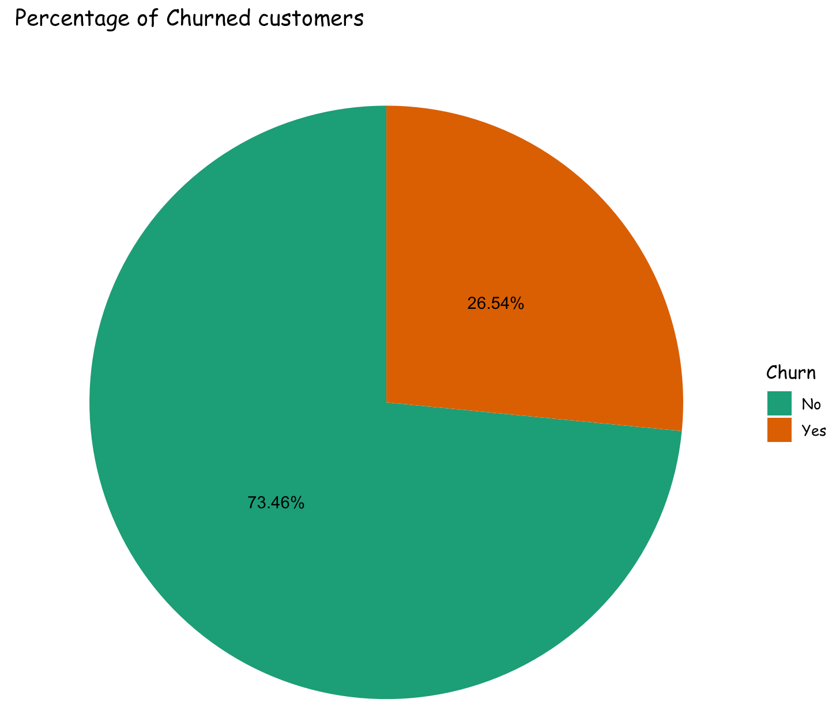
Exploratory Data Analysis
Around 27% of the total customers in this dataset have left the company and we have analyzed the possible reasons/patterns for this behaviour.

Slide 10
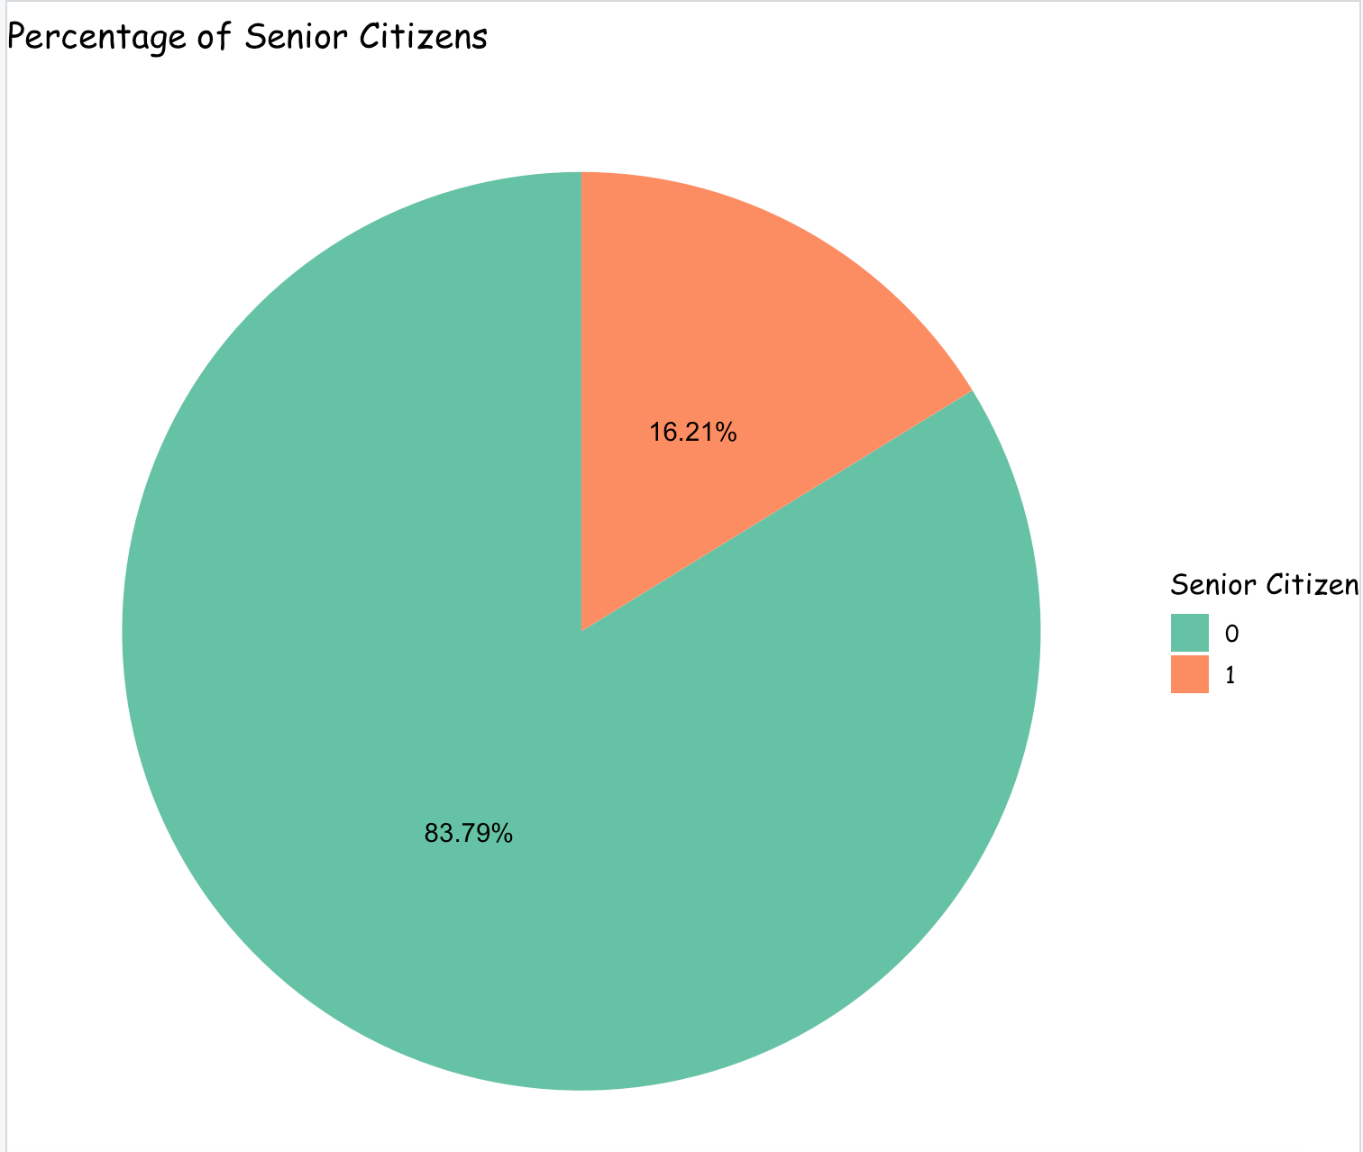
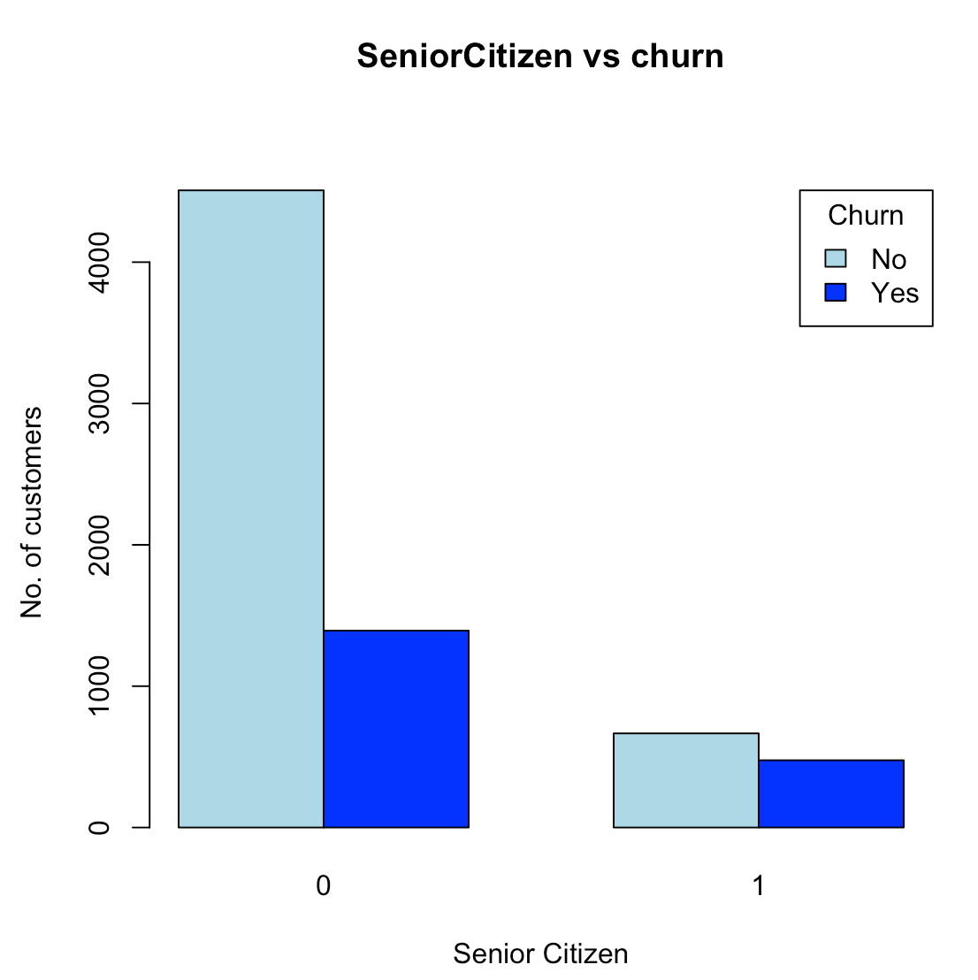
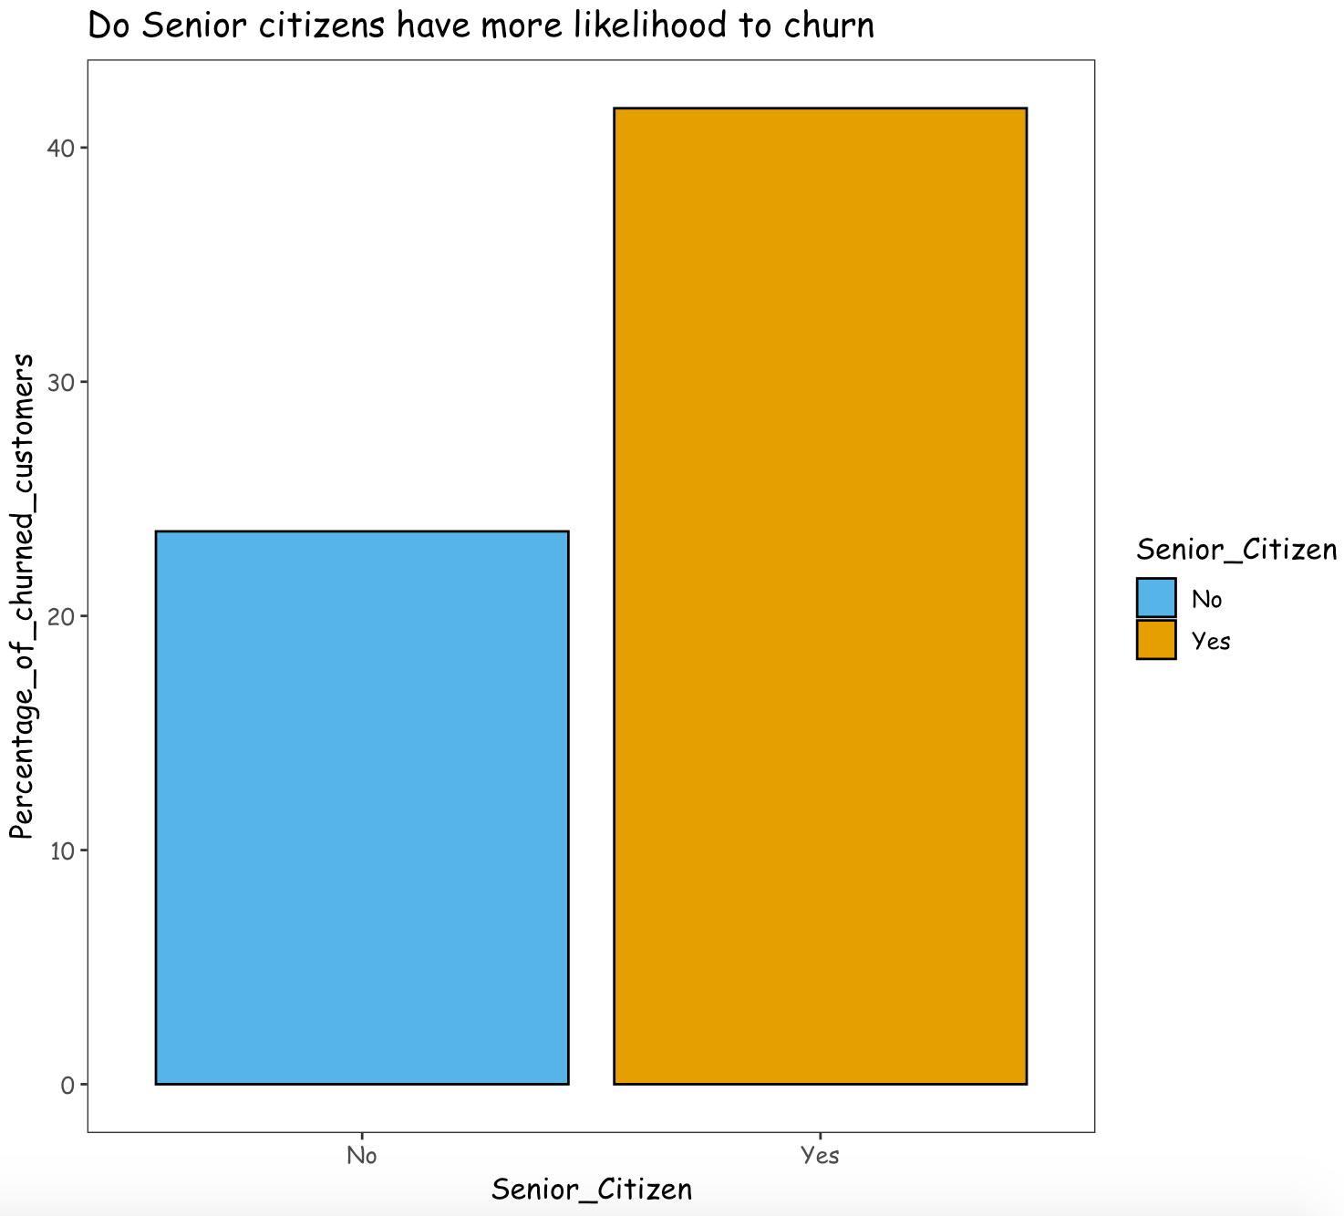
Exploratory Data Analysis
Senior citizens are more likely to churn than the young/middle aged customers.

Slide 11
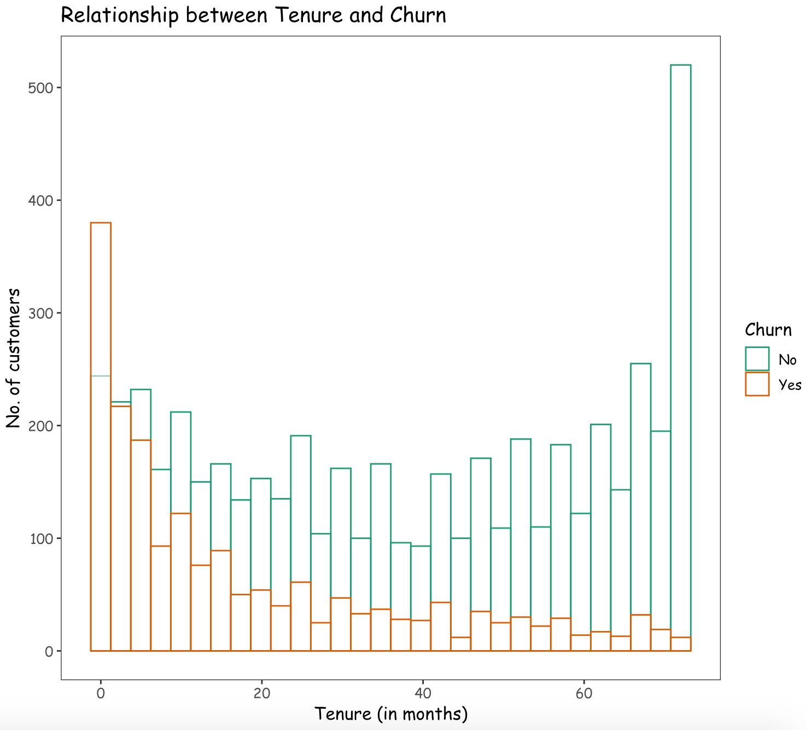
Exploratory Data Analysis
The customers having a longer tenure period tend to stay loyal with the company.

Slide 12
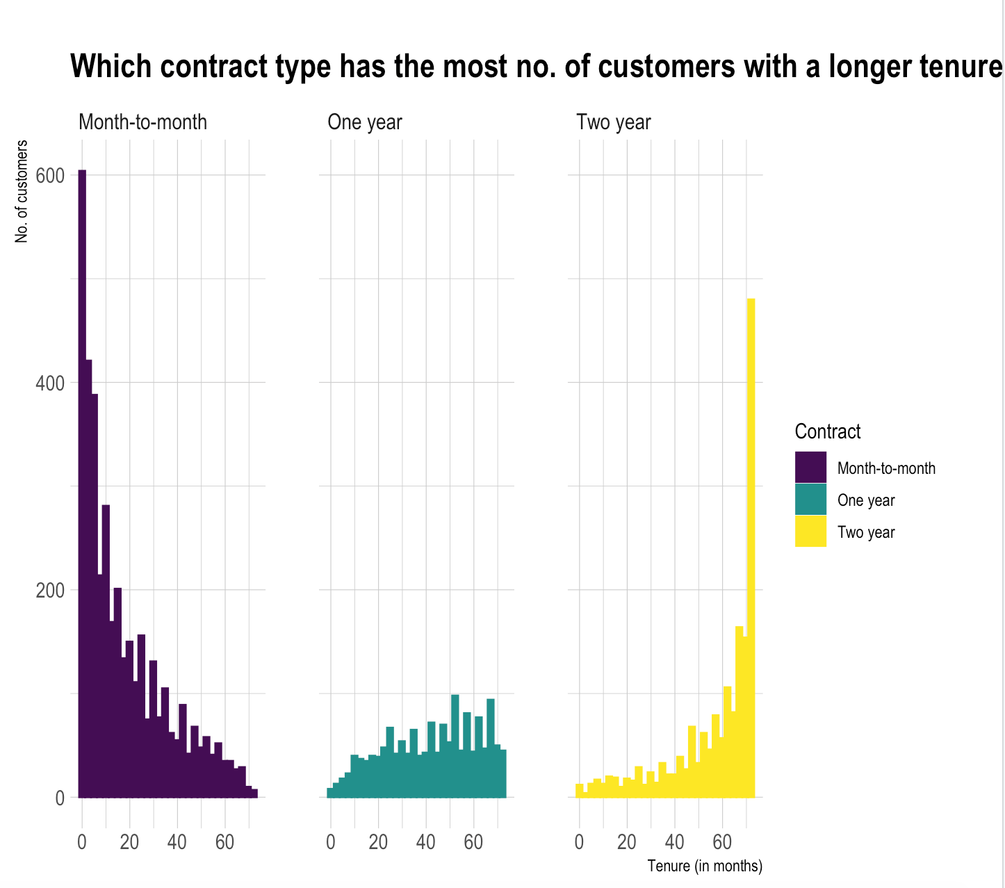
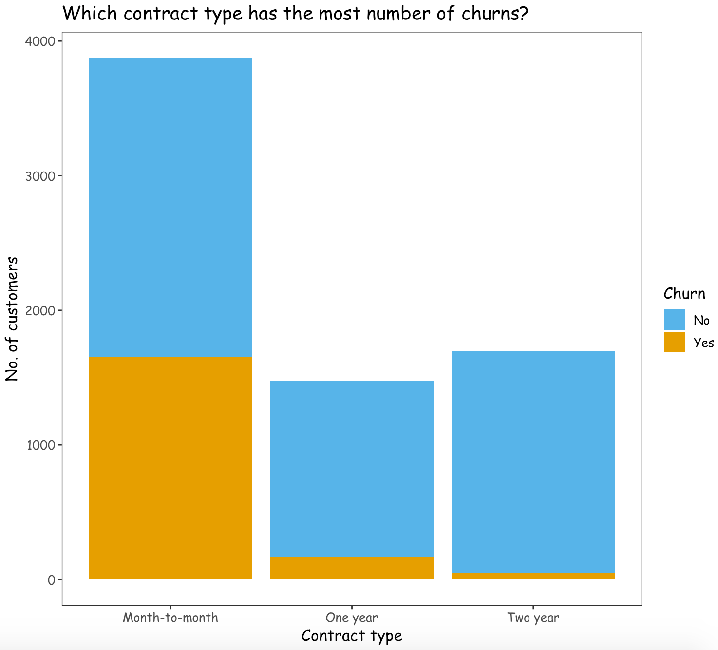
Exploratory Data Analysis
Almost half of the customers with a contract type of Month-to-month have left the company.
The customers with a Two-year contract type tend to be loyal and stay with the company for a longer period of time.

Slide 13
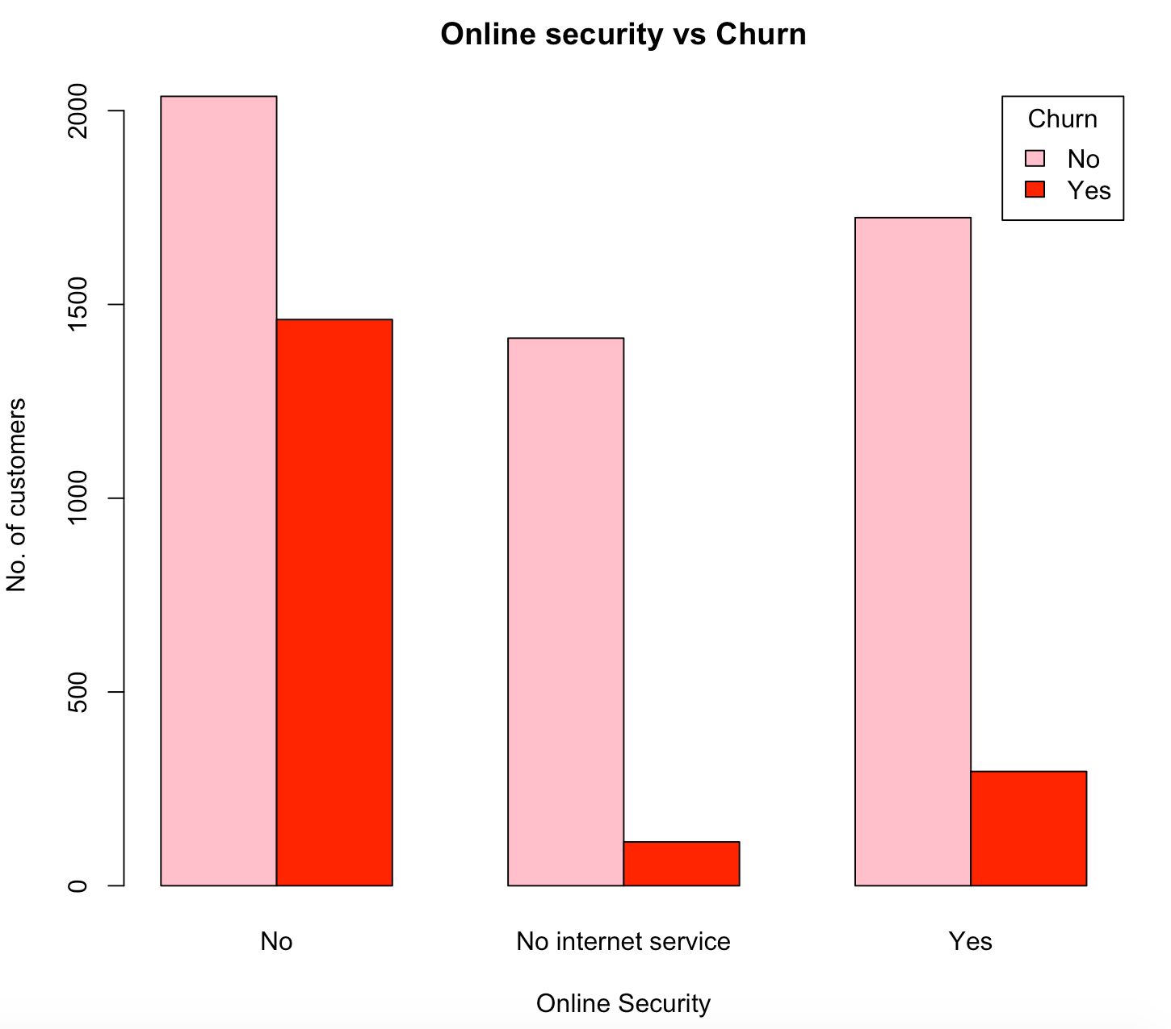
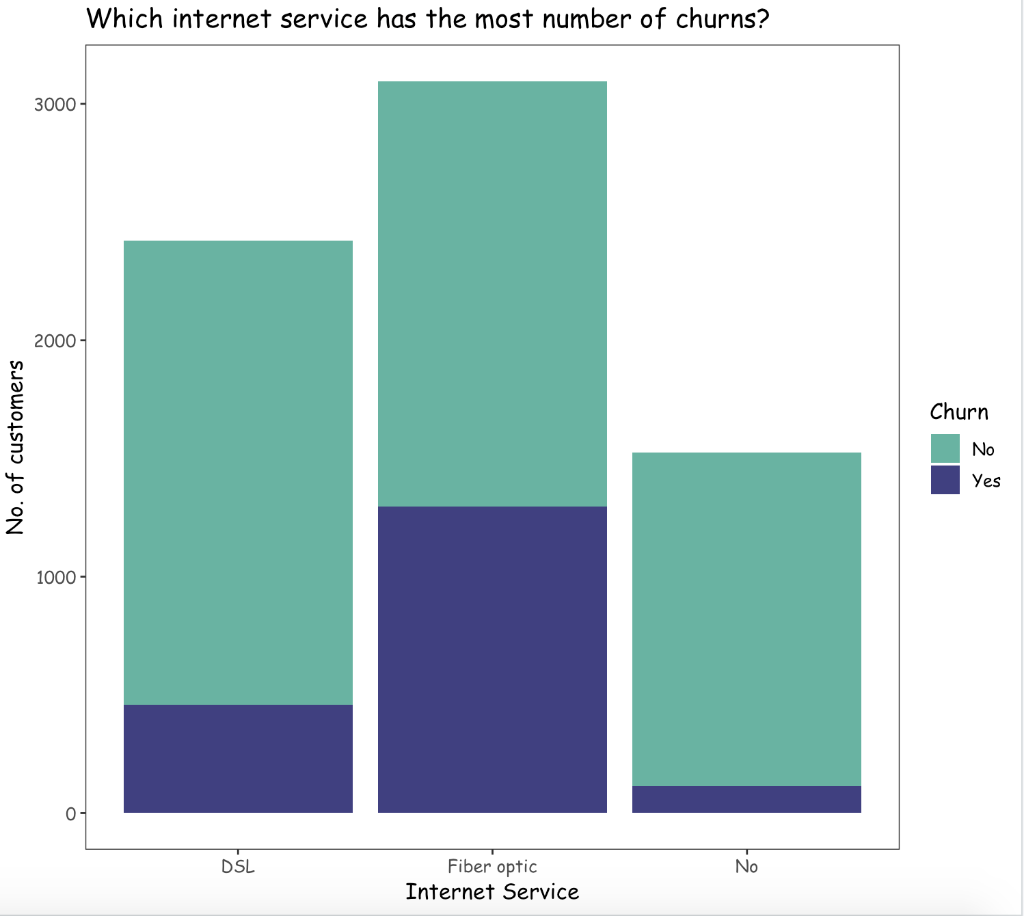
Exploratory Data Analysis
Most of the churned customers were not provided with online security.
The customers opting for an internet service type of Fiber optic, are more likely to churn than with other internet services.

Slide 14
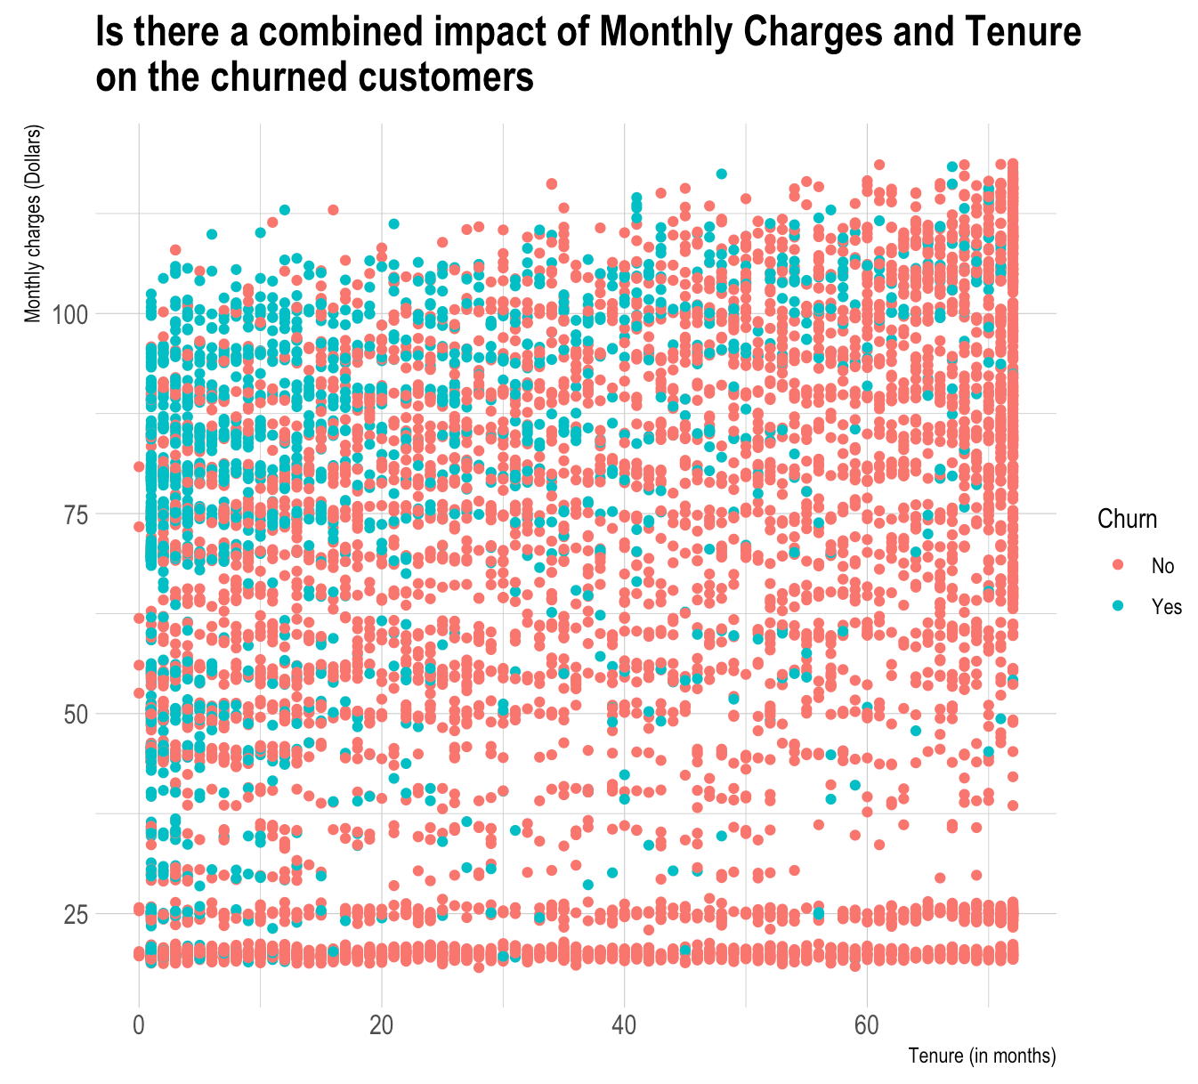
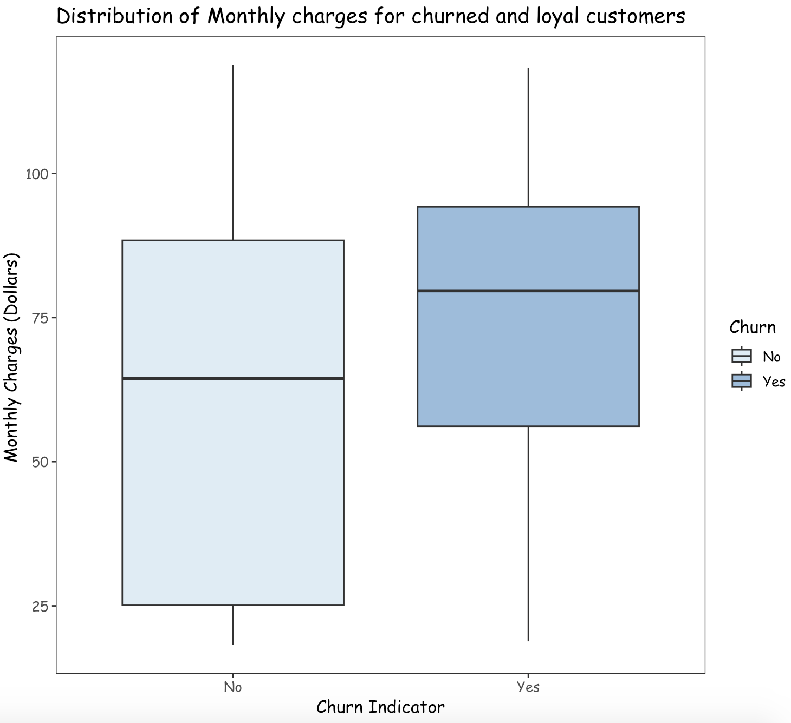
Exploratory Data Analysis
The customers who stayed for a shorter tenure with the company and those who were charged relatively higher monthly charges left the company.

Slide 15

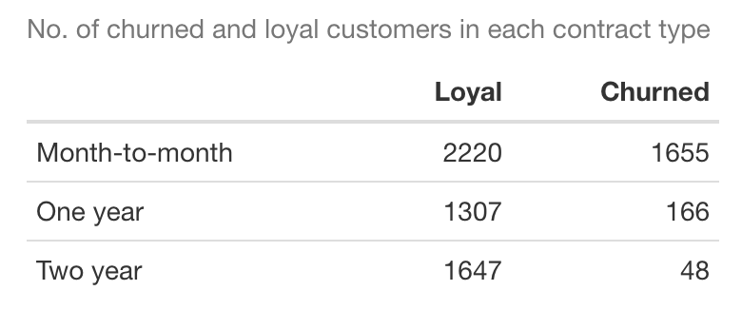
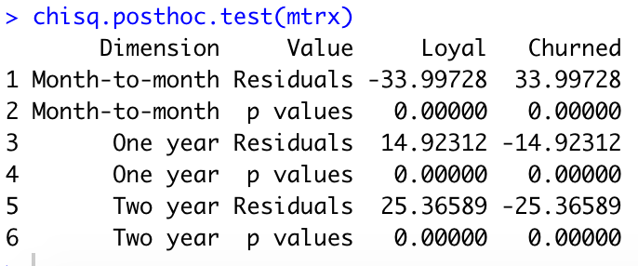
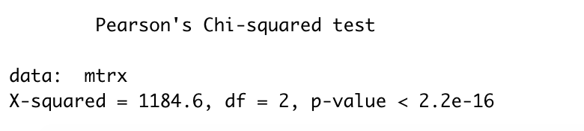

Applying statistical tests - Chi Square and Anova
Are the churned customers independent of the contract type?
H0 : The churned customers are independent of the type of contract.
H1 : The churned customers are dependent on the type of contract
Considering significance level, alpha = 0.05
We can reject the null hypothesis since p-value < alpha (0.05).
Thus there is a sufficient evidence to state that the churned customers are dependent on the contract type.
p-value : 2.2 e -16 | X-squared : 1184.6

Slide 16
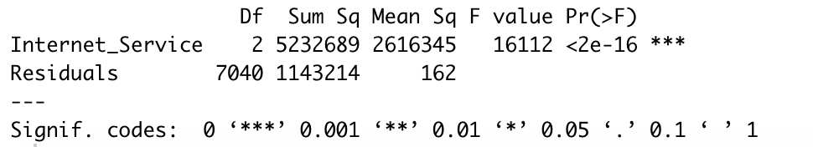
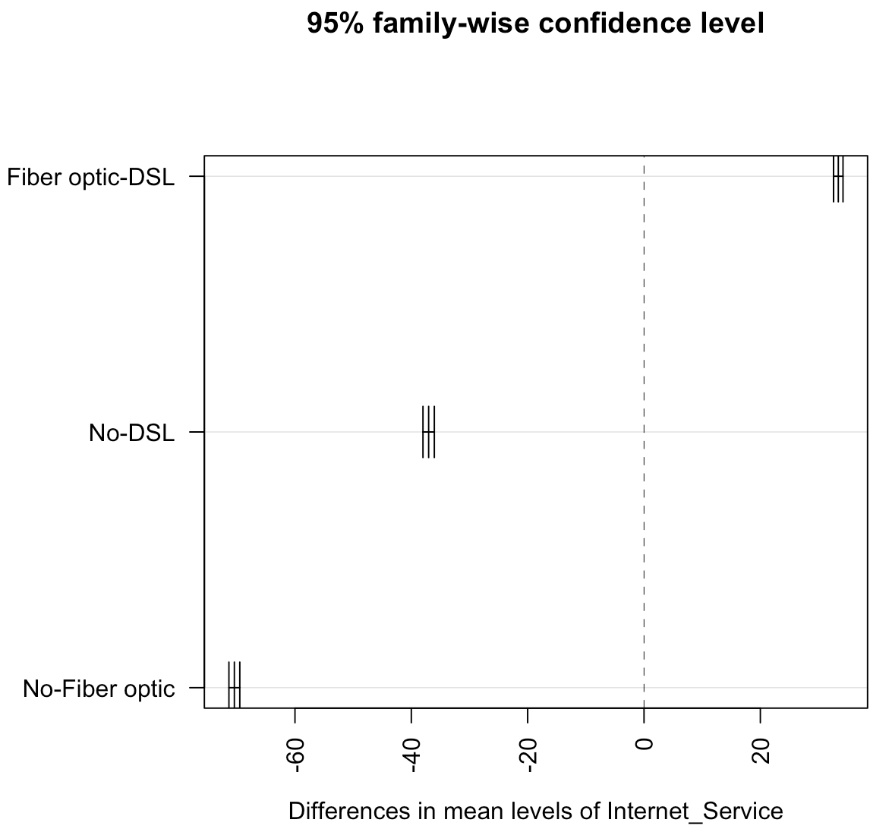
Is the average monthly charge same across all the types of internet service?
H0 : The average monthly charge is the same for all types of internet services.
H1 : The average monthly charge is different for all types of internet services.
Considering significance level, alpha = 0.05
We can reject the null hypothesis since p-value < alpha (0.05).
Thus there is a sufficient evidence to state that the average monthly charge is different for all the types of internet service.
Tukey HSD test indicates that the pair of Fiber optic and DSL internet service has a significant mean difference than the other groups.
p-value : 2 e -16

Slide 17
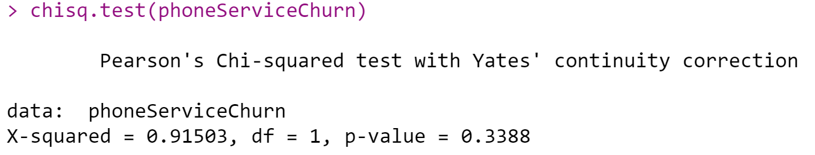
Do any of the Services that Customer has signed up for contribute to the Customer Churn ?
p-value 0.3388 > 0.05.
Do not reject H0.
No sufficient evidence supports H1.
For the Customer Services Online Security , Tech Support has relationship between churn.
Streaming movies and phone service has no relationship with churn
H0: There is no relationship between PhoneService and churn
H1: There is a relationship between PhoneService and churn
(significant level of 0.05)
p-value : 0.3388 | X-squared : 0.91503

Slide 18
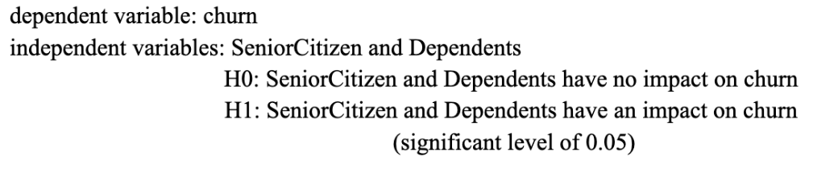
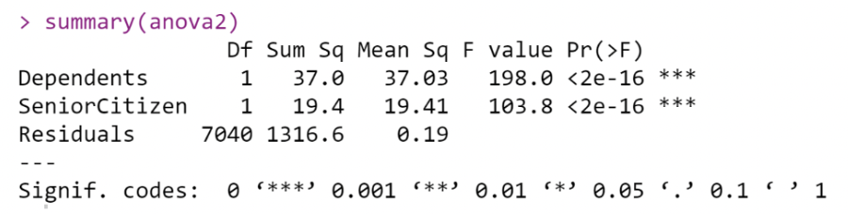
Does demographic information of Customers contribute to Customer churn rate ?
p-value dependents (<0.0000) < 0.05. p-value senior citizen (<0.000) < 0.05.
Reject H0.
There is sufficient evidence that supports H1
Demographic information of Senior Citizen, Dependents, and Partners will affect customers' churn rate. Gender has no relationship with churn.
p-value : <0.0000

Slide 19
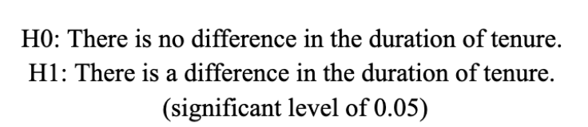
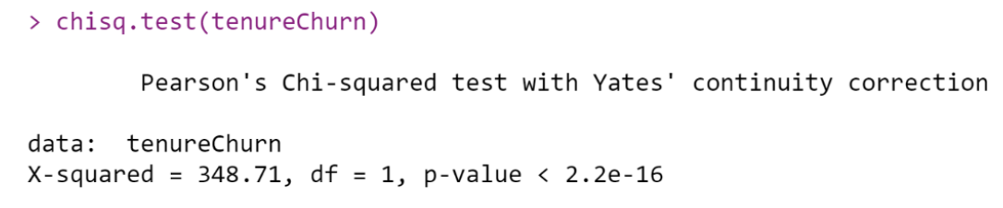
Are Customers with less tenure more likely to be Churned ?
p-value (<0.000) < 0.05.
Reject H0.
There is sufficient evidence that supports H1
The duration of tenure is less than the mean that the customer churn is 38%, and the duration of tenure is more than the mean that the customer churn is 18.1%. So Customers with less tenure are more likely to be Churned.
p-value : <0.0000 | X-squared : 348.71

Slide 20



Analytical Methods
Different analytical methods were used for feature selection and building statistical models
Logistic Regression using GLM
Designed to model and predict the data that has binomial outcome
Logistic Regression
Stepwise Regression
Stepwise Regression
METHODS
Selection of statistically significant features for predictive modeling
Lasso
Lasso Regularization
Ridge Regularization
Reduces model complexity and prevents over-fitting of the model
Ridge Regularization
Reduces model complexity and prevents over-fitting of the model

Slide 21
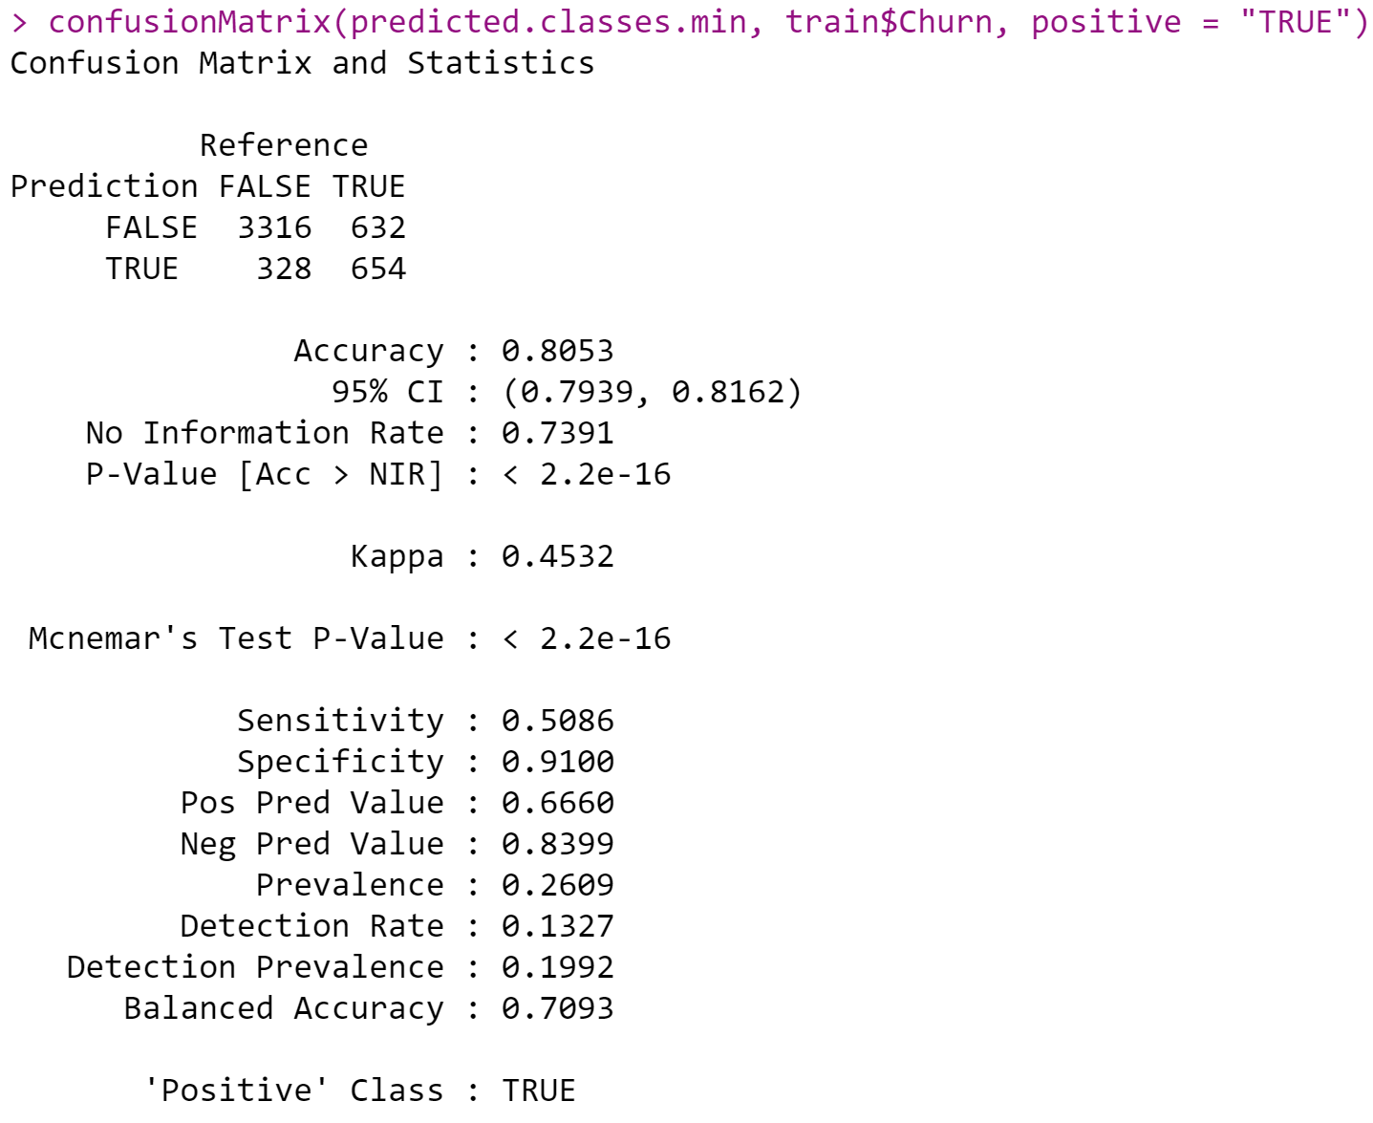
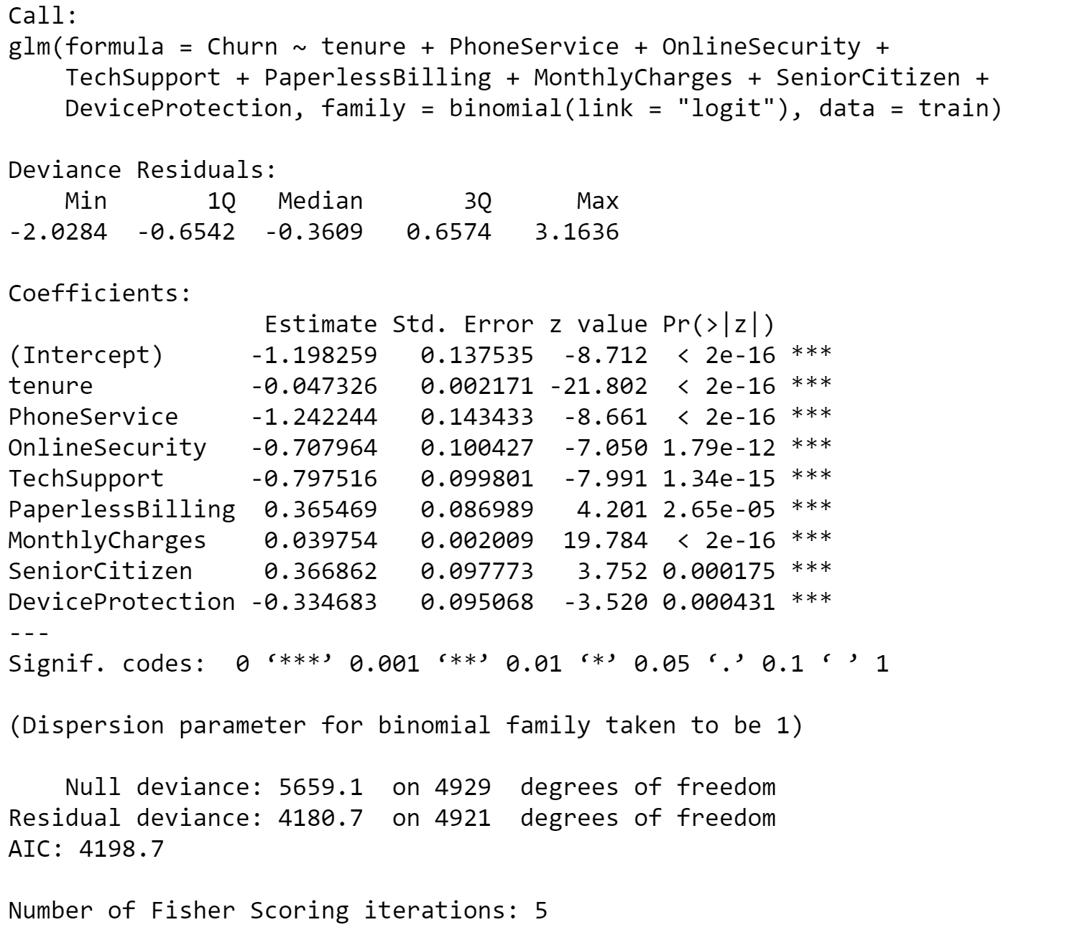
Logistic Regression Model
Logistic Regression is a statistical method used for binary classification problems, where the goal is to predict a binary outcome (Churn 0 or 1) based on one or more independent variables.
tenure, PhoneService, OnlineSecurity, TechSupport, PaperlessBilling, MonthlyCharges, SeniorCitizen, DeviceProtection are significant variables.
By looking at the confusion matrix figure, the accuracy is 0.8053 (80.53%)
RMSE: 0.22 | AIC :4198.7 | BIC : 4257 | AUC : 0.8351

Slide 22
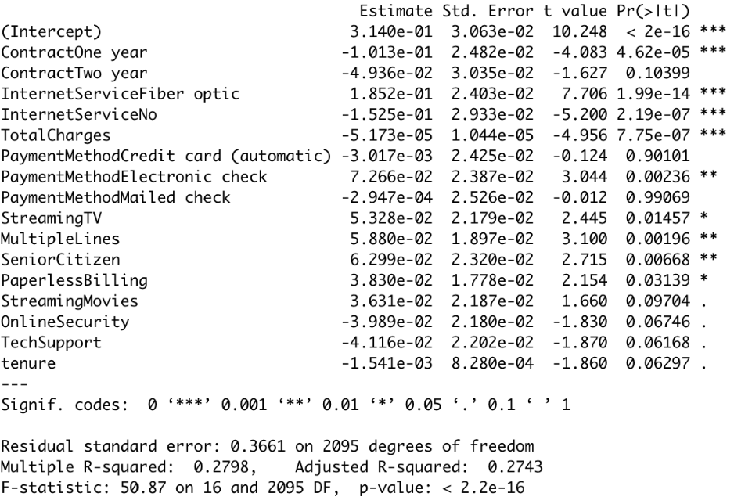
Stepwise -Forward Selection
Forward selection, which starts with no predictors in the model, iteratively adds the most contributive predictors, and stops when the improvement is no longer statistically significant. This is a way of selecting important variables to get a simple and easily interpretable model.
Contract（One year, Two year)，InternetService (Fiber optic, No)，TotalCharges，PaymentMethod（Credit card (automatic), Electronic check, Mailed check)，StreamingTV，MultipleLines are the most contributive predictors.
RMSE: 0.01 | AIC :1768.383 | BIC : 1870.18 | AUC : 0.8439

Slide 23
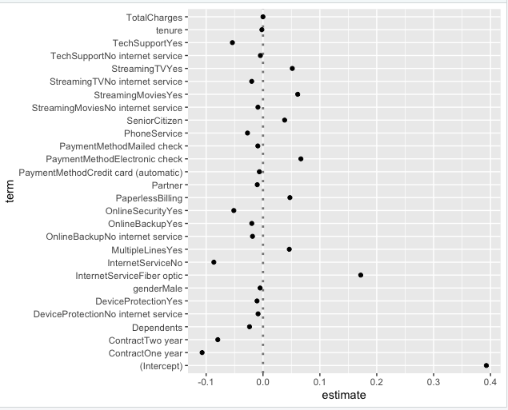
Lasso Regularization
Lasso regularization was used to avoid the over-fitting issue , generate a simpler model for producing more accurate predictions.
Lasso regression penalized some features which contributed to over-fitting of the models.
Features related to Services (Multiple Lines- No phone service, Online Security - No internet service, Monthly Charges ) were deemed to over-fit and add complexity to the model.
Their coefficients were shrunk by the algorithm.
RMSE: 0.01 | AIC : 227.33 | BIC : -1397.50 | AUC : 0.84

Slide 24
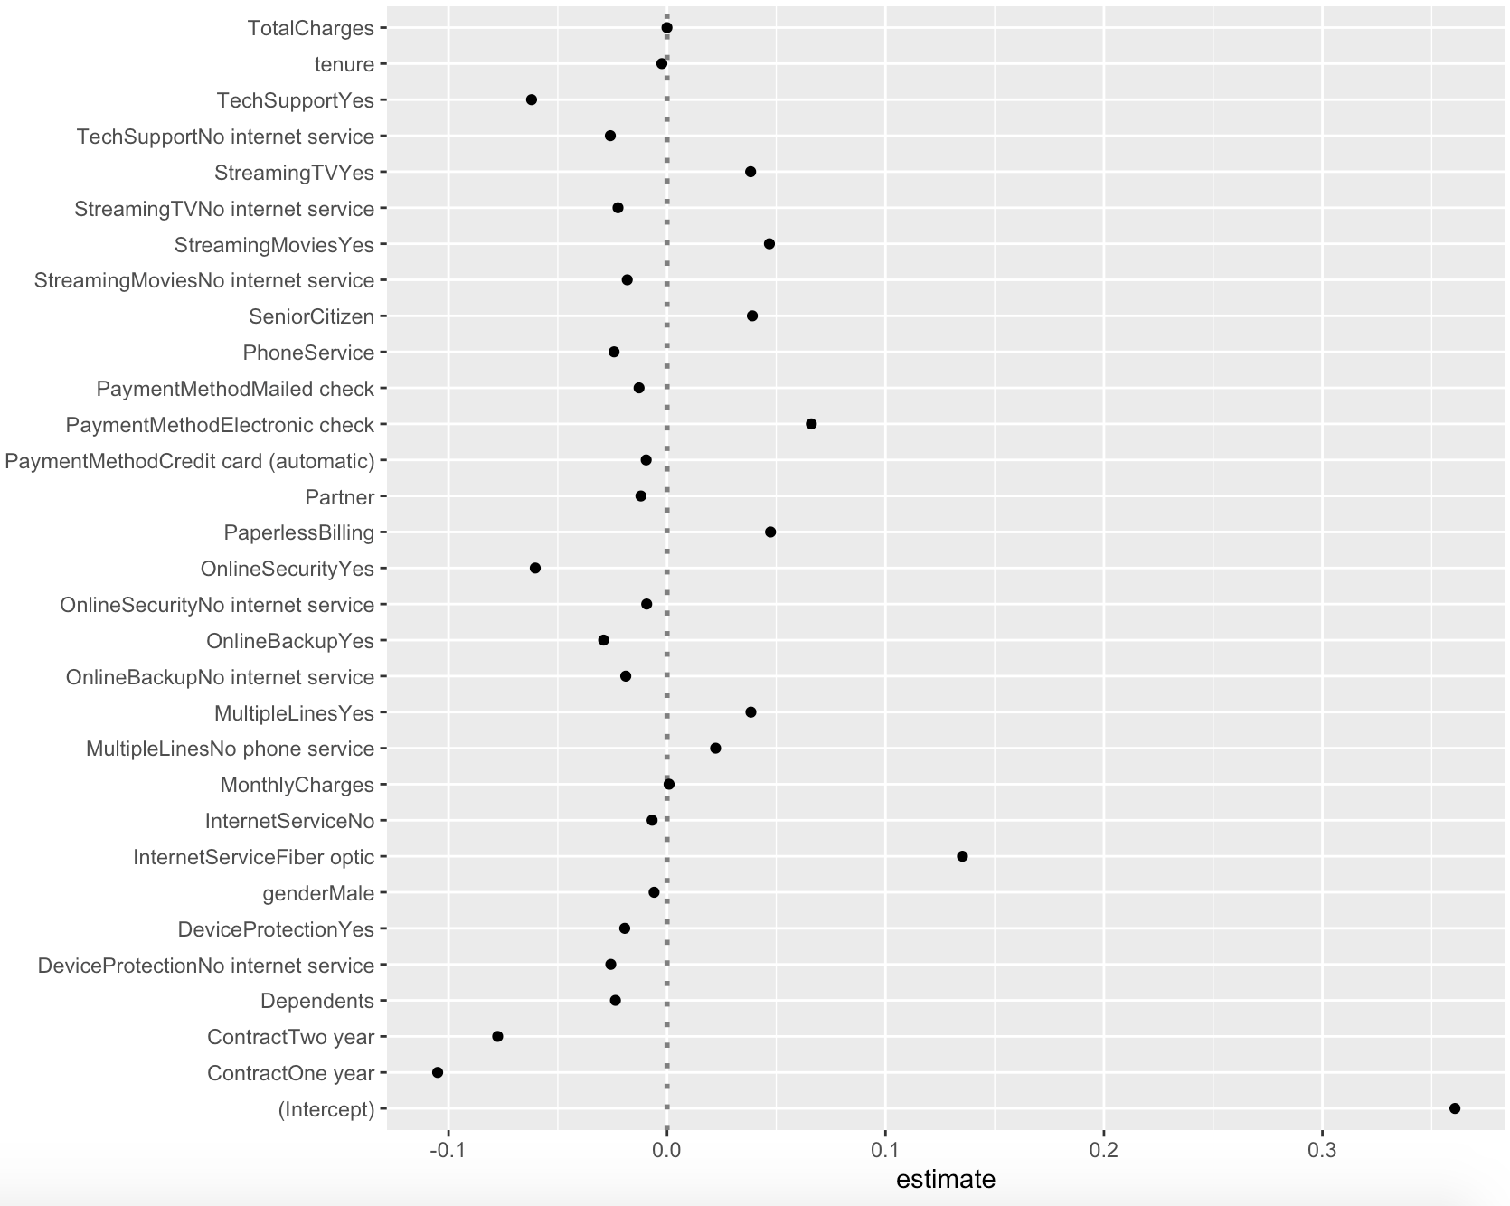
Ridge Regularization
Multicollinearity issue in the model can cause the coefficient estimates of the model to be unreliable and have high variance.
Ridge regularization was used to overcome multicollinearity issue and reduce the complexity of the model.
Ridge regression penalized some features which contributed to over-fitting of the models.
The coefficients of the features like Total Charges, Monthly Charges, tenure, Internet Service ,Online Security (No), gender (Male), Payment Method (Credit card, Mailed check) were reduced towards zero.
There was a reduction observed in the AIC and BIC values, thus the overall model complexity is reduced.
RMSE: 0.01 | AIC : 205.09 | BIC : -1185.51 | AUC : 0.84

Slide 25
Comparison of the Models
METRICS | LOGISTIC MODEL - GLM | STEPWISE - Forward | LASSO | RIDGE
AIC | 4198.7 | 1768.383 | 227.33 | 205.09
BIC | 4257 | 1870.18 | -1397.50 | -1185.51
RMSE (Difference of Training & Test) | 0.022 | 0.01 | 0.01 | 0.01
AUC | 0.8351 | 0.8439 | 0.844 | 0.84
All the four models achieved almost the same level of accuracy of 0.84 and a lesser RMSE error.
In general, BIC is more conservative than AIC and tends to select simpler models.
Lasso regression model can be selected as the best model as it has the lowest BIC value, indicating a comparatively simpler model.

Slide 26

Conclusion
What factors/services that would help predict the Customer Churn ?
Demographics - Senior Citizen , Partner & Dependents
Services - Phone Service , Internet Service (Fiber Optic , No), Multiple Lines (Yes) , Online Security (Yes) ,Online Backup (Yes , No internet Service) , Device Protection (Yes , No internet Service) , Tech Support (Yes , No internet Service) , Streaming TV (Yes , No internet Service) , Streaming Movies (Yes , No internet Service)
Customer Account - Tenure , Contract (One , Two Year) , Paperless Billing , Payment Method (Mailed Check , Electronic Check , Credit card) , Total Charges.
Can we predict the Customer Churn that can help Telco to develop Customer Retention Programs ?
Accuracy of around 84% was achieved with our Lasso Model which suggests that we were able to correctly predict by 84% accuracy if a customer will be churned for Telco along with following factors -
Senior Citizen Customers
Month-to-Month contract type
No Partners/dependents
Shorter Tenure
Internet Service(Fiber Optic)
Electronic Check - Payment Method

Slide 27
References
Telco customer churn. Kaggle. Retrieved February 5, 2023, from https://www.kaggle.com/datasets/blastchar/telco-customer-churn
Bluman, A. (2017). Elementary Statistics: A Step By Step Approach (10th ed.). McGraw-Hill Education.
Kabacoff, R., I. (2022). R in Action, Third Edition. Manning.

Slide 28


